Slide 1
CREATING AN ARCHIVE
America’s Boating Club
Valley Forge

Slide 2
First Part
How we Started
Process
Who did what
Issues encountered
Second Part
Organization of the Archive
Who is responsible
Where we are now
Susan P. Woron, Chair of Archive Committee

Slide 3
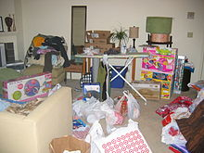
Starting out…
Research what’s been done
What do we want to do?
How to organize the archive?
Who should help?
Who can access the archive?
Who controls access?
What will our archive be used for?
Susan P. Woron, Chair of Archive Committee
Notes:
In the beginning we had some discussions at our ExCom meetings, but different people had different views.
I looked at the D5 archive and it seemed very complex.
Most of our beginning questions were answered by D5 Joe Gibson. Joe saved us a lot of time by not going off in tangents and keeping our focus in mind.
We got into various issues like those stated above.
BUT, someone has to make those decisions without wasting a lot of time and going down the wrong roads.

Slide 4
Research and Thinking Things Through
What to do
What not to do
Proceed cautiously
Use others’ experiences
Committee: who should guide the squadron?
Chair and webmaster
Don’t just jump in
What talents does the squadron have?
Choose carefully; I chose people to help Webmaster decided on what vehicle to use to store the archive
Susan P. Woron, Chair of Archive Committee
Notes:
Discuss: Listen to ExCom; talk to Joe; bounce ideas off key people
I decided to chose a group of past Commanders because they would have the background knowledge to understand the issues and documents. I extended an invitation to them to serve on a committee. No one refused, but they didn’t exactly accept either.
Webmaster (Joe Pezely) met to discuss Dropbox and why it would be a good choice. Joe set up dropbox on my laptop so it would be easier to use.

Slide 5
Purpose of the Committee
To retain squadron documents so that we have a history and a record of what we do.
To pass along information so that squadron officers, chairs, and members can access information on events, positions, and background knowledge.
Susan P. Woron, Chair of Archive Committee
Notes:
Think through these 2 items carefully. Although we were retaining documents, we also felt that we could use the archive to pass along information from one person to the next.
Passing along information was a problem for us. People kept records according to their own needs. Some passed it along to the next person and some did not. We felt we could pass information along through the archive to train people in their new position, to save documents, flyers, etc. so we didn’t have to completely develop them with each new person. We could even put in contact people, hotel information, marina information, maps, menus, etc. and it could all be saved. That way each person coming into a position didn’t have to start from scratch.

Slide 6
Philosophy of the Committee
Members agreed that:
The system should be easy to use.
The documents should be easy to locate.
There should be some ability to edit at least some of the documents, in addition to just storing them.
The documents should be submitted in a required format so that they may be stored quickly and easily. We need to agree on the format.
Susan P. Woron, Chair of Archive Committee
Notes:
Joe Pezely and I started off with a basic outline based on officers and their roles and who reports to them. Refer to “Organization” handout.
I held some meetings but very few people attended them. I held the meeting anyway using an agenda, and wrote up minutes. I distributed everything through email and put all documents on dropbox.
I kept updating the ExCom and putting small ads in our newsletter about what we were doing. Sometimes I would contact members of the committee and ask for their feedback.
We put everything on dropbox so the committee could easily find it and respond. Some meetings were online, or decisions were done by survey.
Eventually more people became interested, or were recruited to our mission.
We started off with this philosophy.
Easy to use– required or no one will use it.
Easy to locate– or no one will use it
Edit some of the documents– Joe Gibson said “No” because it’s an archive. We agreed with that and agreed to open another dropbox for “working documents”
Required format- Joe Gidson calls these “tools”. These are basically formats that are used for submitting documents. We haven’t gotten there yet as I need some training and time to look at these on the D5 website.

Slide 7
Issues
Access: Who gets in?
Who uses the system?
Process: If I want to store something, how do I do it?
Quality Control: Do we store everything or select what is stored?
Quantity: How much can we store?
Where do we start?
Who should be on the Committee?
A select group of Past Commanders, Webmaster, Chair, current Commander
Research: Need a free, easy to use system.
Susan P. Woron, Chair of Archive Committee
This Photo by Unknown Author is licensed under CC BY
Notes:
Access: The Webmaster controls the access.
Process: Officers store their own documents, or a person can send a document to me. Mostly we have people storing their own documents. But I now have 3 volunteers to help me.
Quality Control: Officers store whatever they want. There’s too much stuff to go through to set standards for quality etc. Our members are very efficient and competent.
Committee: see above
Research: Keep up with what’s happening at D5 and what the Committee wants

Slide 8
Dropbox: Easy to use, Free ORGANIZATION: We used the same outline As is used for our meetings What is archived: Rosters; Treasurer’s Reports; Minutes and attendance at ExCom; awards; links; newsletters; job descriptions; officers’ notes, flyers, documents; info on Events and flyers; cruise Who does it: Officers and those in charge of events; archivist and helpers Photos: general photos are kept in facebook, the website, and our newsletters photos for the archive: awards and historical photos (Commanders, change of watch Quality Control: Officers and those running events save what they want, and delete what they want Training and access: people have been pretty good about learning or their own or they contact the webmaster for help.
Decisions, decisions…
Susan P. Woron, Chair of Archive Committee
This Photo by Unknown Author is licensed under CC BY-SA-NC

Slide 9
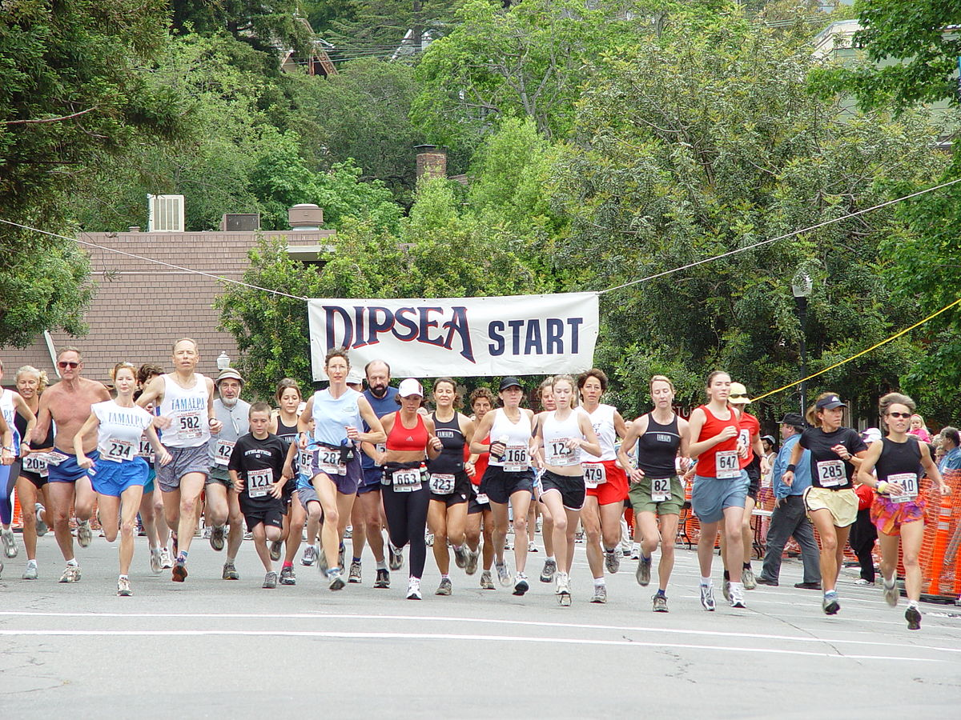
Getting Started
Research: what are others doing?
Communications: ExCom, newsletter, email
Form Committee: I chose PC’s, also Webmaster, current Commander, volunteers
Discuss: Purpose of your archive; philosophy; create an outline
Set up Dropbox: webmaster gets everyone connected, trained, and creates account
Meetings: Discuss issues, take surveys, some online work, review system so far
Create the system: Chair designed the first system
Revise the system: and your decisions
Susan P. Woron, Chair of Archive Committee
Notes:
To review and put this in a working order.

Slide 10
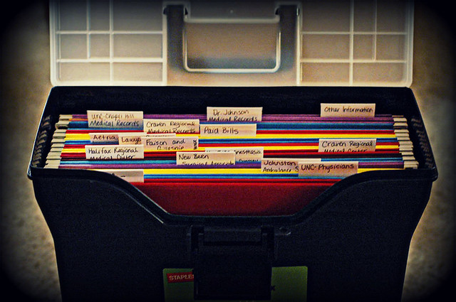
Additional Decisions (after first year):
Basically, the Archive should be used to save historical documents (Historian’s Report, Treasurer’s Report, Roster, and meeting minutes).
The Archive is not a working space but a place where we save FINAL documents for reference and squadron history.
No one should edit anything in the Archive. Webmaster limits permissions to avoid editing. Save Treasurer and Secretary’s Reports in PDF format so they will be more difficult to alter.
The person who created the document will upload it.
Create a list of documents to be stored and who will be responsible for uploading.
Use links instead of whole documents to save space.
Uploads are NOT monitored.
Use a tagging system for photos and awards.
Start the archive with 2019; go back when there is time.
Next Steps: Look at the “tools” under “Resources” on the D5 website. Attend training.
Get everyone to upload their documents.
Susan P. Woron, Chair of Archive Committee
This Photo by Unknown Author is licensed under CC BY
Notes:
Things I learned after making mistakes. These decisions have now been accepted by our squadron and we are moving forward.

Slide 11
Next Steps
Get more people to use the archive.
Learn how to use “Tools” on the D5 website
Check to see that everything for 2019 and 2020 is archived
Go backwards to include more from the past.
Susan P. Woron, Chair of Archive Committee

Slide 12
Organization of Valley Forge Squadron Archive Archive Introduction and Organization Commander Annual Rosters Audit Report Commander Responsibilities for the Archive Commander’s Picnic Fund Committee Law Officer Legislative Officer List of New Officers/ OD – 2 Form Merit Marks Operations and Leadership Training Rules Committee/ Bylaws D5 Conference Executive Department Pilot issues Pilot Ads Boat Shows Vessel Safety Check Change of Watch Public Relations/ Advertising Social Media Facebook Website Veteran’s Events Administrative Department Administrator’s Duties Membership Rendezvous/ Boating Activities Summer Cruise Dinner Meetings Events
Secretary’s Department Minutes and Attendance List of Delegates attending conferences Squadron History Historian’s Report Awards and Photos Founders’ Day Communications Supplies Property Inventory Archivist Treasurer’s Department Treasurer’s Report Educational Department List of classes offered and taught Attendance List/ students/ locations Public relations/ recruiting Nominations Committee Links and Resources Logos and Banners Brochures and Printed Materials Copyrights and Trademark Links
Susan P. Woron, Chair of Archive Committee

Slide 13
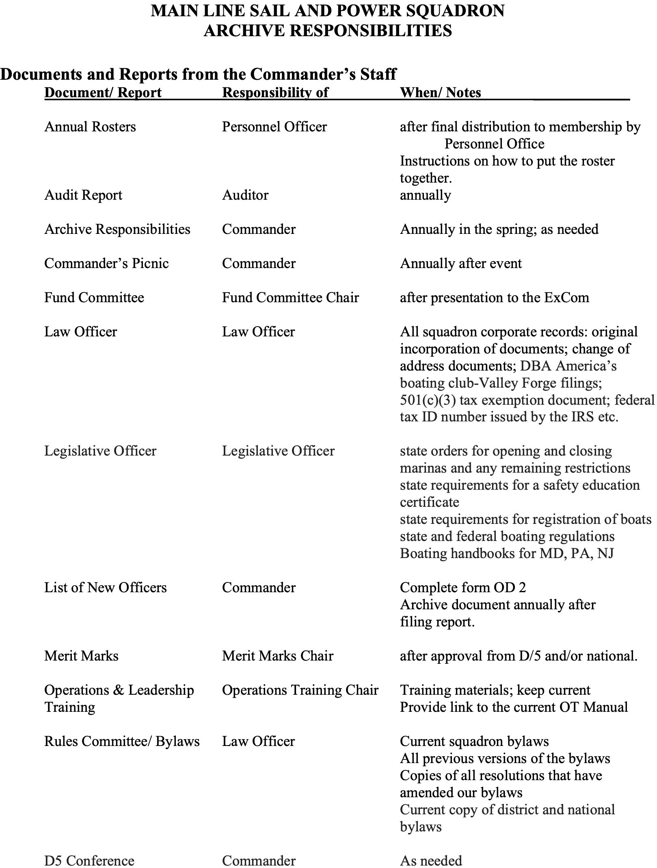
Susan P. Woron, Chair of Archive Committee

Slide 14
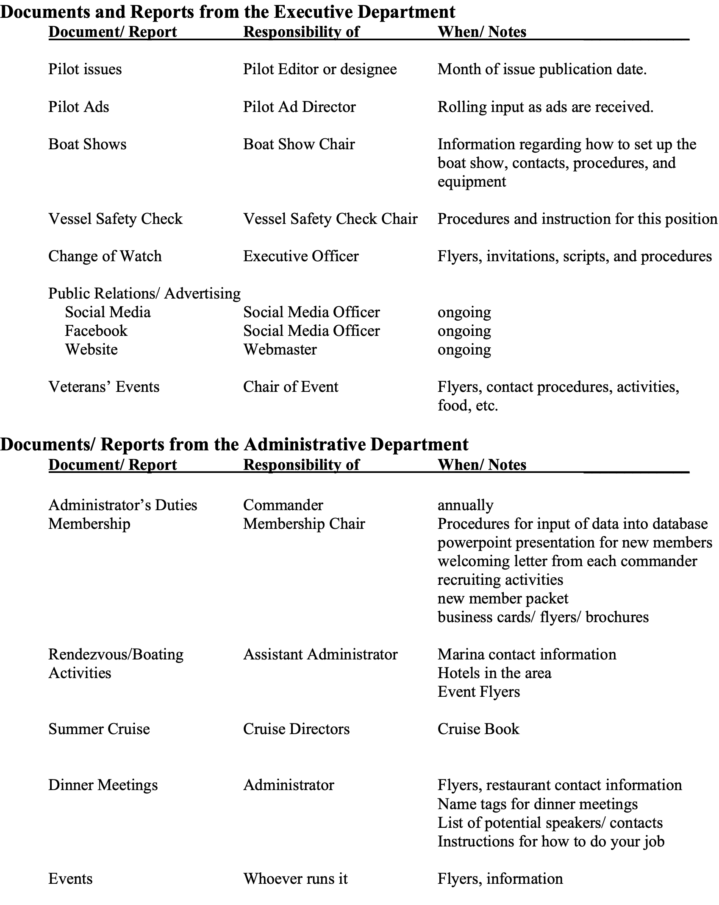
Susan P. Woron, Chair of Archive Committee

Slide 15
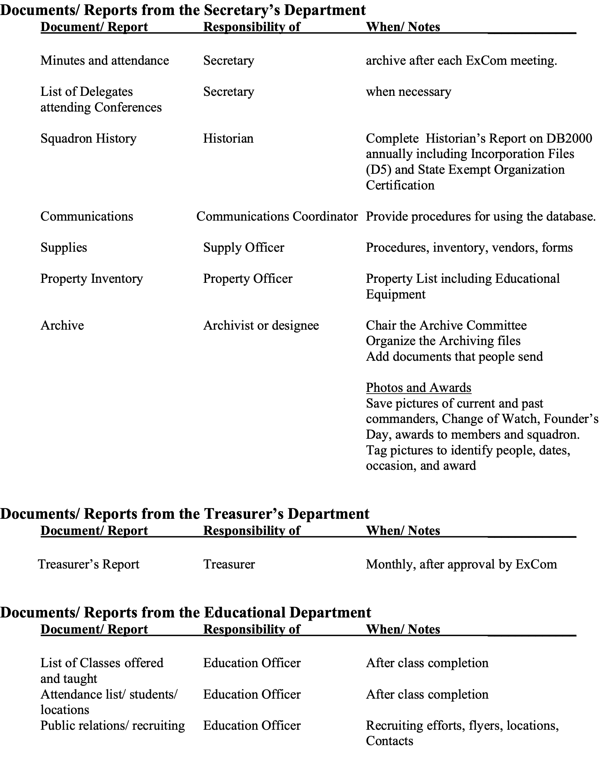
Susan P. Woron, Chair of Archive Committee

Slide 16
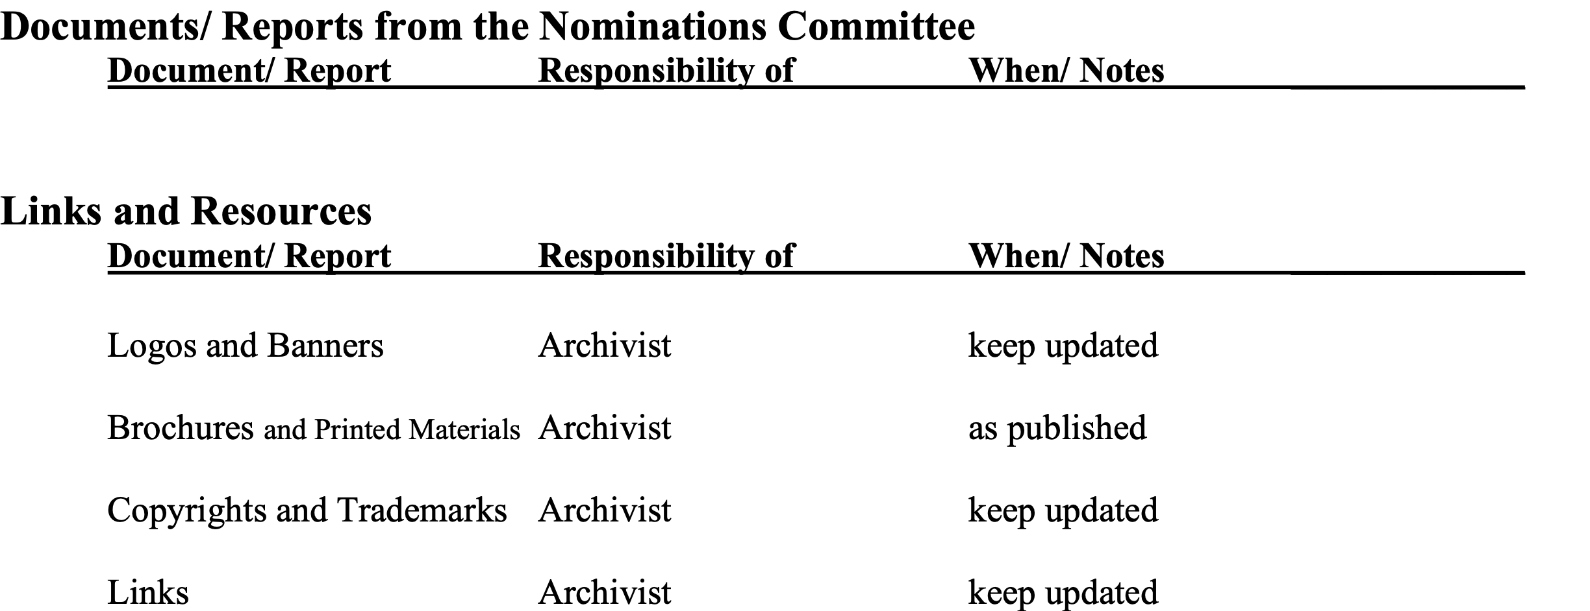
Susan P. Woron, Chair of Archive Committee

